Slide 1
NCI grant meeting with Ty and Nidhi
09152023 Zoom meeting
Notes:
summary: some patients have high clonal expansion of T cells upon ICI, is this a metric for predicting irAE development?

Slide 2
Outline
Overall goals
10X Proposal
10X Results

Slide 3
Models for the relationship of Immune related adverse events (irAE) and objective responses (OR) to immune checkpoint inhibitors (ICI)

Slide 4
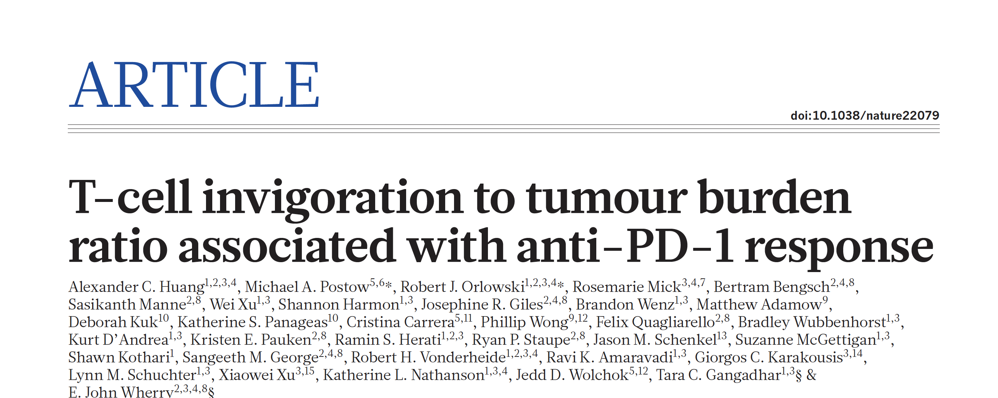
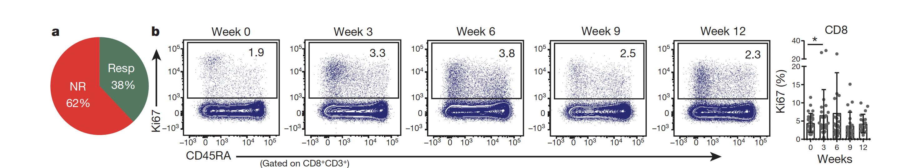
T cell reinvigoration in cancer patients by anti-PD-1 treatment
Huang AC, et al. T-cell invigoration to tumour burden ratio associated with anti-PD-1 response. Nature. 2017 May 4;545(7652):60-65. PMID: 28397821.
Notes:
Summary of key findings:
melanoma patients have more exhausted T cells than healthy patients
often see PD-1 blockade-induced changes in circulating, exhausted PD-1⁺ CD8⁺ T cells (increased proliferation, reinvigoration, especially the more exhausted the T cells were i.e. CTLA-4⁺ and PD-1⁺), but this doesn’t always mean a clinical response
reinvigorated T cells from blood are also found in TME
see correlation between tumor (antigen) burden and CD8⁺ T-cell reinvigoration (increased Ki67 proliferation), augmented by PD-1 blockade
larger baseline immune responses (higher pre-treatment Ki67 levels in PD-1⁺ CD8 T cells) indicates poor prognosis, perhaps because a larger baseline immune response indicates a larger tumor burden
clinical failure mostly from imbalance between T cell reinvigoration and tumor burden; clinical response correlates with magnitude of T cell reinvigoration relative to baseline tumor burden

Slide 5
Proposal: 10X profiling of reinvigorated CD8+ T cells during ICI therapy
Peter Linsley, Erik Wambre, Maochang Liu and Hannah DeBerg
June 24, 2020

Slide 6
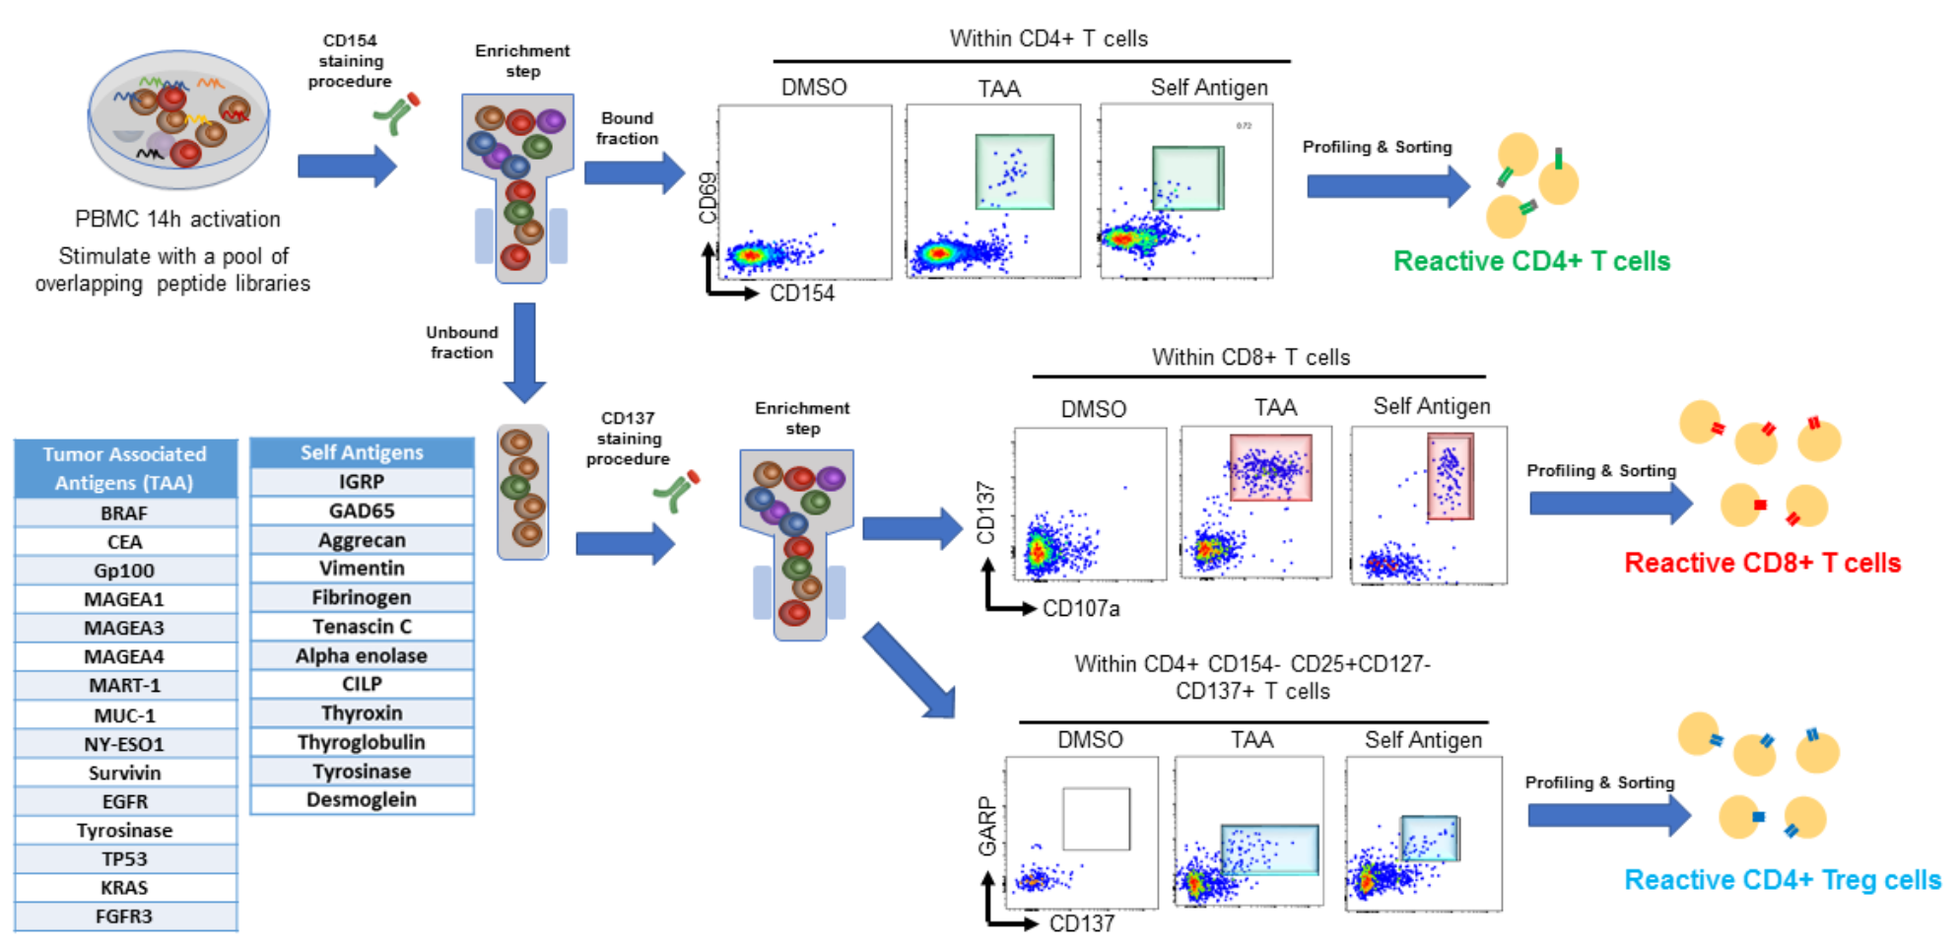
Characterization of tumor- and auto-antigen-reactive CD4 Teff, CD8 Teff, and CD4 Tregs at the single cell level
Notes:
- sequential analysis of tumor and auto antigen specific T cells
- stimulate cells with pool of TAAs or self-antigens
- CD154 marks antigen-specific CD4 T cells, 1st get CD154⁺ CD69⁺ (another activation marker) CD4⁺ T cells
- CD137 marks antigen-specific CD8 T cells, so 2nd get CD154⁻CD137⁺CD8⁺ T cells
- then get antigen-specific CD4⁺ Tregs (CD154⁻CD137⁺GARP⁺,CD25⁺CD127⁻)

Slide 7
Characterization of tumor- and auto-antigen-reactive CD4 Teff, CD8 Teff, and CD4 Tregs at the single cell level

Slide 8
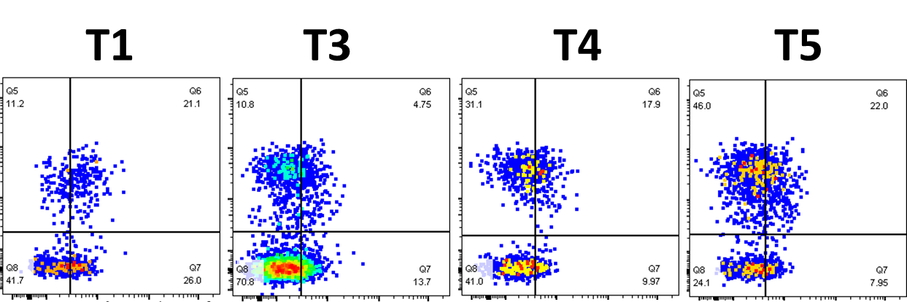
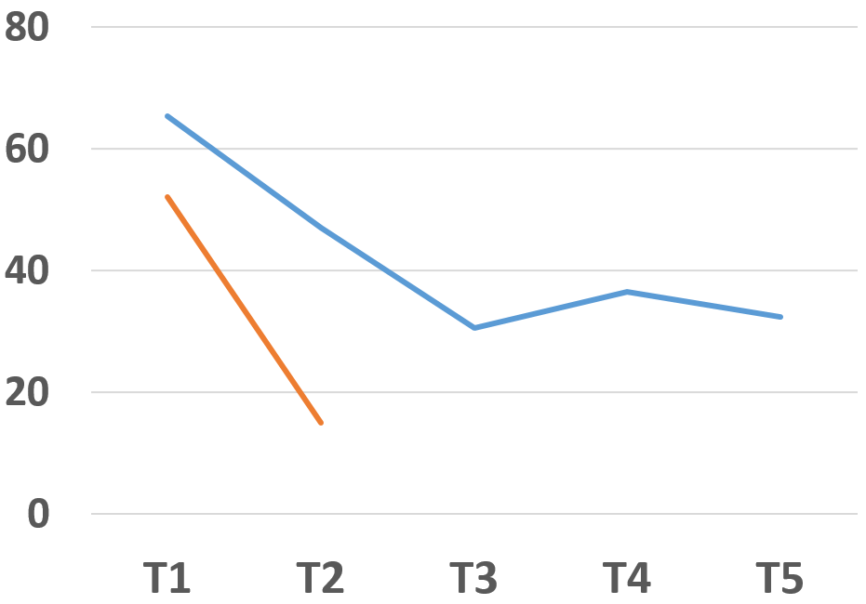
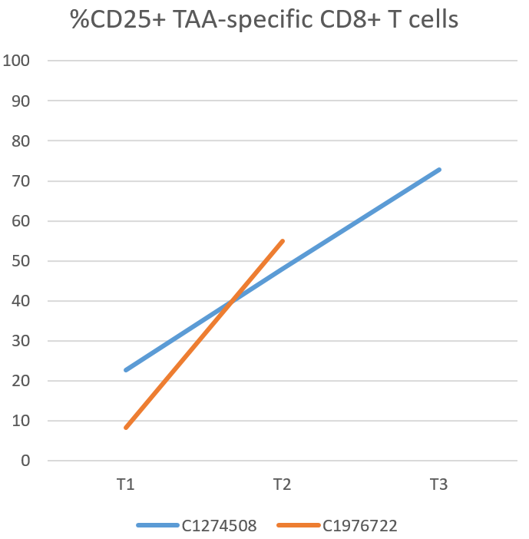
Reduction in TIGIT+ Tumor-reactive CD8 T cell responses during ICI
(65.3%)
(30.5%)
(36.5%)
(32.3%)
CD137
TIGIT
% PD1+ TAA-reactive CD8 T cells
% TIGIT+ TAA-reactive CD8 T cells
Notes:
TIGIT is a co-inhibitory receptor in CD28 protein family, expressed on activated T cells, some Tregs, Tfh, NKs
TIGIT ligands are CD155, CD112 on APCs, T cells, tumor cells
CD226 is a co-stimulatory receptor that binds to same ligands as TIGIT, so TIGIT and CD226 compete for ligands and lead to inhibition or activation, respectively
CD137 marks antigen-specific CD8 T cells
Reinvigoration (TIGIT means exhausted)

Slide 9
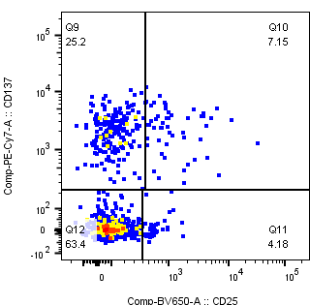
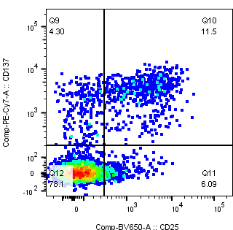
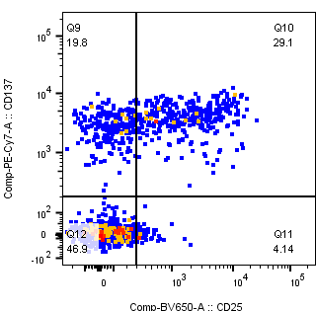
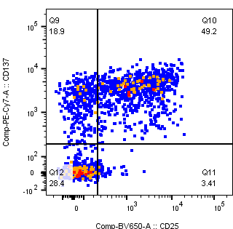
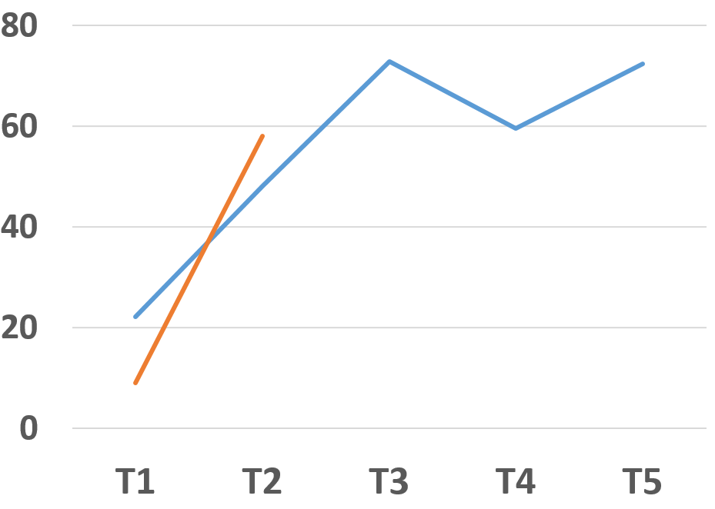
Increase of CD25+ Tumor-reactive CD8 T cell responses during ICI
(22.1%)
(72.8%)
(59.5%)
(72.3%)
CD137
CD25
% PD1+ TAA-reactive CD8 T cells
T1 = pre-therapy
Notes:
CD25 marks Tregs, so these are CD8 Tregs

Slide 10
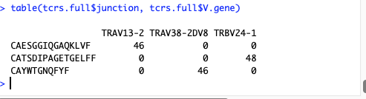
Surprise: massive CD8+ response in second CPI-treated subject also was monoclonal, with different TCR sequences
Notes:
CPI is checkpoint blockade immunotherapy
all these CD8⁺ T cells were all targeting the same epitope/antigen with same TCR sequences (different patients)

Slide 11
TAA-reactive CD8 T cells are predominantly of a single clonotype
Mean of 73+/- 23% of cells share TCRs, N = 6 experiments. 2/6 have dual TRAV; 2/6 have dual TRBV; 4/6 have dual TRGV.

Slide 12
Proposal
Hypothesis: Exhausted TAA-specific CD8+ T cells become more activated and less exhausted during treatment with anti-PD1. This response may not be reflected in other exhausted cells (EBV/CMV) and in bulk non-antigen specific cells
Test: Combined plate sorting and 10X experiment on four sequential samples from a T cell “reactor” patient
Notes:
What might be the rationale for anti-PD1 relieving exhaustion in this context but not with chronic viral infections (EBV, CMV)?
- different microenvironments? TME vs. whatever the viral infected tissue microenvironment is called…
- perhaps because viruses can hide in cells

Slide 13
Measuring re-invigoration of CD8 T cell populations during ICI therapy at the single cell level
Step 1:
Plate sort
PBMC from
T cell reactor (T1)
TAA and EBV/CMV-specific
48 cells each
Identify antigen-specific TCRs
track antigen-specific TCRs
Step 2:
5’ 10X
PBMC from
T cell reactor (T1, T2, T3, T5)
Enriched memory and TAA-specific CD8 T cells,
50,000 cells
Identify bulk TCRs and single cell transcriptome profiles

Slide 14
Defining the features of T cell responses to tumor and self-antigens as predictors of response to checkpoint inhibitor therapy
Peter Linsley
NCI meeting
May 11, 2023

Slide 15
Acknowledgements
Investigators Team Members
Jane Buckner Cliff Rims
Peter Linsley Hannah DeBerg
Erik Wambre Maochang Liu
Alice Long
Genomics core
Clinical groups at BRI, UTA, VMFH,
and FHCC
Laura Chow (UT Austin)
John Paul Flores (VMFH)
Petros Grivas (FHCC)

Slide 16
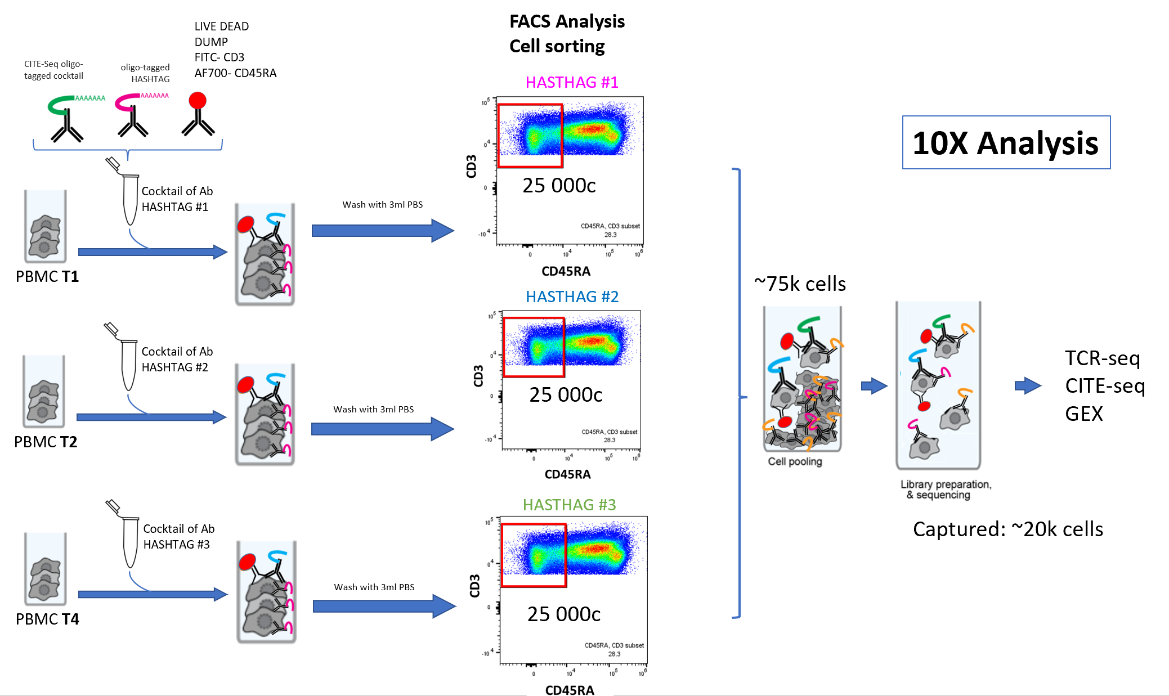
10X experimental plan with unsorted CD3+ cells
Notes:
CD3 is a T cell co-receptor, so just all T cells here
Not enriching for antigen-specific cells

Slide 17
Outline
Sequence sharing in autoantigen (AA) and tumor-antigen (TA) reactive TCRs
Annotating cells along the 10X trajectory
Fates of AA, TA, and foreign antigen (FA) reactive T cells after checkpoint inhibitor (CPI) therapy
Notes:
TA here does include neoantigens (see next slide)

Slide 18
Identification of TCR barcodes with three specificities
TA reactive TCRs – from cells activated with a mixture of peptides from tumor associated antigens and peptides with cancer associated neoantigen mutations (ML, EW, and PSL)
AA reactive TCRs- from cells activated with a mixture of peptides from rheumatoid arthritis and type 1 diabetes antigens (CR, and JB)
Foreign antigen (FA) reactive TCRs- TCRs reactive with CMV, EBV, Influenza A or YFV viral antigens in the VDJdb database
Notes:
What do ML, EW, and PSL mean here? Also CR and JB?
Do we know if there are any overlaps between TA and AA sets here? I wouldn’t think so but could have implications for results

Slide 19
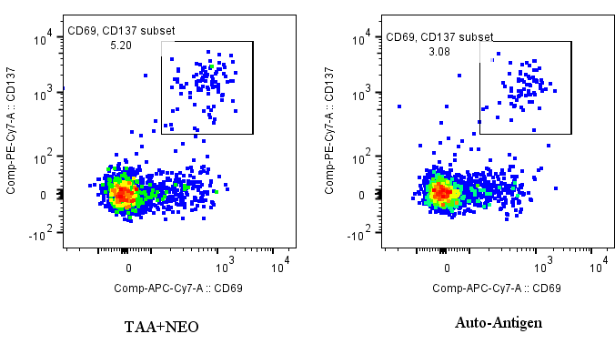
Single cell sorting of activated TA and AA CD8+ populations from a head and neck cancer patient
TA
AA
TA is mixed 15mer pool including 10 TAA proteins, NEO is 15mer pools designed by Peter, (0.5ml TCM with 3ul TAA+3ulNEO)
AA is from Cliff, include cit-Tenascin, arg-Tenascin, and Islet antigens (GAD65,GRP78,IAPP,IGRP,Insulin).
(0.5ml TCM with cit-Tenascin 1.4ul, arg-Tenascin 2.5ul, Islet 2.1ul, based the peptides number
Notes:
CD137 marks antigen-specific CD8 T cells

Slide 20
Plate-sorted Ag specific cells are enriched for AA and TA clones relative to their frequency in 10X
Notes:
Way to read this is AA1 for example for 10X 1 in 10,000 (rarest) antigen reactive cells
Higher on right because there was enriching done (enriching for antigen specificity)

Slide 21
Highly expanded clones from cells activated with both TA pol and AA pools
TA pool
AA pool
TAA1
AA1
TAA2
AA2
AA3
Notes:
What kind of plot is this?

Slide 22
Shared TCR sequences between TCRs isolated with AA and TA pools
Bold font indicates AA and TAA clones sharing TCR junction sequences. A total of 14/229 (~6%) unique junctions were shared between TA and AA TCRs (6 TRA, 8 TRB).
Notes:
Surprise that 1 seq for auto antigen and tumor antigen were same, so polyreactive clone
CDRs 1-3 are the junction regions (I think)
CDR3 junction between V and J segments
CDRs 1/3 determine peptide specificity
CDRs 1-2 in V region & determine MHC specificity

Slide 23
Extensive TCR junction sharing between TA and AA reactive cells
Notes:
Lines are sequence matches?

Slide 24
Outline
Sequence sharing in autoantigen (AA) and tumor-antigen (TA) reactive TCRs
Annotating cells along the 10X trajectory
Fates of AA, TA, and foreign antigen (FA) reactive T cells after checkpoint inhibitor (CPI) therapy

Slide 25
Cell clustering by visit seems largely consistent without batch alignment
29,734 cells (10,709, 10,202, and 8,823 for visits 1-3, respectively)
Notes:
Batch effects: unwanted variation, systematic bias in data from technical rather than biological differences between cells (i.e. from processing, sequencing runs, reagents, experimental conditions)
Trajectory analysis: pseudotime through cell state progression, perhaps here it’s like visit 1 → 2 → 3 ? Not sure how to see from figures though (i.e. I can’t see which is 1 vs. 2 vs. 3), from next slides going to assume kind of left to right (naïve to exhausted)
Just an issue with fig download. Visits NOT associated with specific clusters which is good (small changes shouldn’t be seen really?)

Slide 26
Trajectory can be broken into a “top” fork and a “bottom” fork
top
bottom

Slide 27
Marker expression localizes naïve and exhausted cells along the trajectory
naive
Tex1
Tex2
Notes:
CCR7, SELL: naïve markers
GZMB: cytotoxic marker
TCF7, TOX: exhausted markers

Slide 28
Distinct distribution of Tex markers at termini of top and bottom forks
Tex2
Tex1
Notes:
TIGIT is co-inhibitory receptor

Slide 29
Granzyme gene expression varies between Tex1 and Tex2 clusters
Tex1
Tex1
Tex2
Notes:
granzymes: cytotoxic T cell method of lysing target cells, inducing apoptosis

Slide 30
Activated cells cluster in multiple locations

Slide 31
Provisional cell assignment along the trajectory
Tex2
Tact1
Tnaive
Tact2
Tex1

Slide 32
Outline
Sequence sharing in autoantigen (AA) and tumor-antigen (TA) reactive TCRs
Annotating cells along the 10X trajectory
Fates of AA, TA, and foreign antigen (FA) reactive T cells after checkpoint inhibitor (CPI) therapy

Slide 33
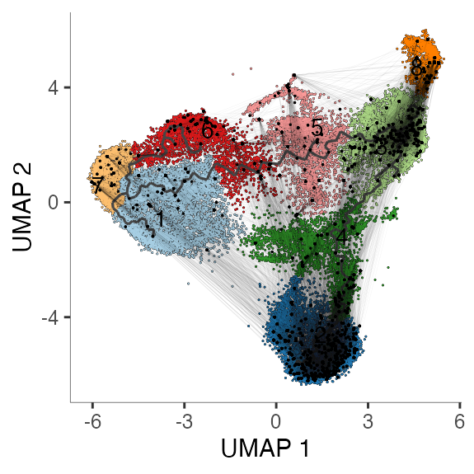
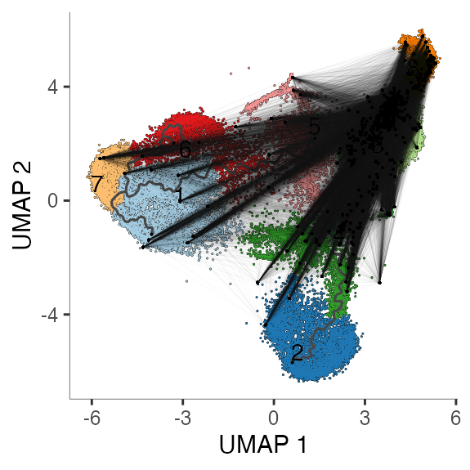
Different distributions of TA/AA and FA expanded clones
VDJdb FA cells
TA/AA cells
Plots show all three visits pooled
Notes:
Airline plot
Takehome: different distributions between FA and TA/AA cells

Slide 34
Distinct changes in distribution of TA/AA reactive cells after CPI treatment
TA and AA sp. cells
FA sp. cells
VDJdb FA cells per cluster
TA/AA cells per cluster
***
*
****
***
*
*
*
*
**
Asterisks indicate significance (uncorrected p-values) of difference of cells in each cluster for Visits 2 and 3 with Visit 1.
Notes:
FA: expansion of cluster 2, reduction of clusters 1, 3, 7
TA/AA: visit 2 has spike in clusters 4 and 8 I believe (perhaps relates to paper where they saw a single burst of reinvigoration of T cells following ICI?)

Slide 35
Multiple routes of “invigoration” after CPI treatment?
TA/AA reactive cells
FA reactive cells
Tact1
Tact1
Tex2
Tex2
Tnaive
Tnaive
Tact2
Tact2
Tex1
Tex1
Arrows indicate most significant changes that occur after CPI therapy. Long arrows indicate most significant changes.

Slide 36
Conclusions
Substantial TCR sharing between TA and AA reactive TCRs suggests multi specific TCRs
Tex cell markers map to two distinct branches on UMAP plots (PD1hi and NK-like)
Changes in cell frequencies per cluster suggests different routes of CD8+ T cell invigoration after CPI treatment

